Slide 1
Lantern Knight Game engine
Andrew McKee

Slide 2

Goals
Game Loop
Character Movement
Animation and Map Generation
Interactable Items

Slide 3
Contents
Main Package
Entity Package
Object Package
Tile Package

Slide 4
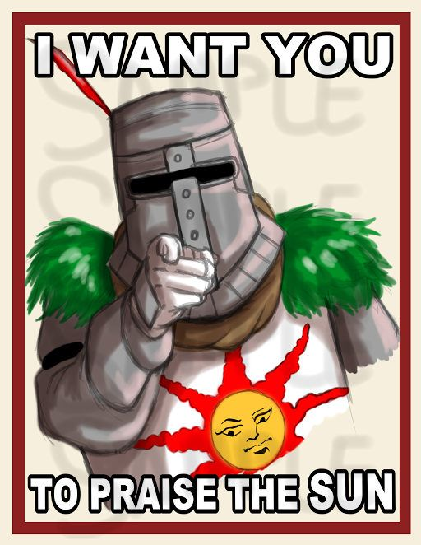
Main Package
Main
Game Panel
Key Handler
Object Setter
UI
Collision Detection

Slide 5
Entity Package
Entity Class
Player Character
Rectangle/Hitbox class

Slide 6
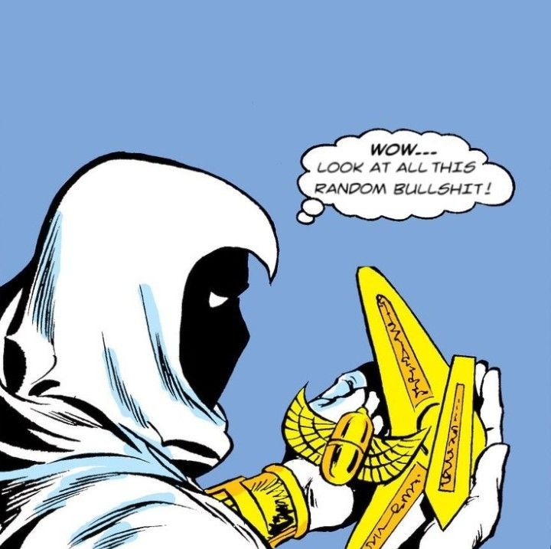
Object package
Defines all objects: Chests, Keys, etc.

Slide 7

Tile Package
Tiles
Tile Manager

Slide 8
Credits
Character Sprites – Mega Tiles
Tiles – Anokolisa

